Slide 1
FINANCIAL STATEMENT ANALYSIS
Topic 10: Analysis of inventories
Presented by:
Dr. Judy Taylor
Lecturer
School of Economics and Finance

Slide 2
Student learning objectives
10.1 Compute ending inventory balances and cost of goods sold using the LIFO, FIFO, and average cost methods to account for product inventory and explain the relationship among and the usefulness of inventory and cost of goods sold data provided by the LIFO, FIFO, and average cost methods when prices are 1) stable or 2) changing;
10.2 Discuss how inventories are reported in the financial statements and how the lower of cost or market principle is used and applied;

Slide 3
Student learning objectives
10.3 Analyze the financial statements of companies using different inventory accounting methods to compare and describe the effect of the different methods on cost of goods sold and inventory balances, discuss how a company’s choice of inventory accounting method affects other financial items such as income, cash flow, and working capital, and compute and describe the effects of the choice of inventory method on profitability, liquidity, activity, and solvency ratios;
10.4 Discuss the reasons that a LIFO reserve might decline during a given period and discuss the implications of such a decline for financial analysis.

Slide 4
References
White, G. I., A. C. Sondhi and D. Fried. (2003). The Analysis and Use of Financial Statements. (3rd edition). Wiley. Chapter 6.

Slide 5
Objective 10.1
Inventories
Inventories as recorded in the balance sheet comprise finished goods held for future sale, work in progress and raw materials and supplies held for the future production of goods
In the U.S. GAAP requires that irrespective of the inventory costing method used, inventories are to be valued on the basis of lower of cost or market
IAS 2 designates FIFO (First In First Out) and weighted average costs as the benchmark treatment and LIFO (Last In First Out) as the allowed alternative

Slide 6


Objective 10.1
Inventories
As a general rule inventories may be calculated as follows:
  (10.1.1)
  where
  EI is inventories balance at the end of the period
  BI is inventories balance at the beginning of the period
  P is the cost of goods and services acquired during the period
  COGS is the cost of goods and services sold during the period
Rearranging formula 9.1.1 gives the following, where the variables on the left hand of the equation are known and in order to prepare the Income Statement and the Balance Sheet they need to be allocated between EI and COGS
  (10.1.2)

Slide 7
Objective 10.1
Inventories
The allocation of BI + P between CGOS and EI may be determined by a number of methods, including:
  First In, First Out (FIFO)
  Last In, First Out (LIFO)
  Average cost

Slide 8
Objective 10.1
First In, First Out (FIFO)
It is assumed that inventory is sold in the order in which it is purchased such that the cost of goods sold in the current period is assumed to equal the cost of inventory goods first acquired
Ending inventory is assumed to comprise the goods most recently acquired, which have not as yet been used to produce goods sold

Slide 9
Objective 10.1
Last In, First Out (LIFO)
It is assumed that inventory is sold in the reverse order in which it is purchased such that the cost of goods sold in the current period is assumed to equal the cost of inventory goods last acquired
Ending inventory is assumed to comprise the goods first acquired, which have not as yet been used to produce goods sold

Slide 10
Objective 10.1
Average cost
Both the cost of goods sold and the ending inventory is assumed to be based on the average cost per unit by dividing the cost of goods available by the total units available

Slide 11
Example 10.1.1
BI + P
The beginning inventory comprises 200 units at $10/unit and the ending inventory comprises 300 units
100 units were sold in each of four successive quarters
In quarters 1 through 4 the purchases were 100, 150, 150 and 100, respectively
Quarters | Stable Price Scenario | Rising Price Scenario
1 | $10/unit | $11/unit
2 | $10/unit | $12/unit
3 | $10/unit | $13/unit
4 | $10/unit | $14/unit
Calculate the value of purchases and the value of inventory at the beginning of the year under each scenario.

Slide 12
Example 10.1.1
BI + P
Under both scenarios BI = $2,000
Stable price scenario | Rising price scenario
Q1 purchase 100 @ $10 = $1,000 | Q1 purchase 100 @ $11 = $1,100
Q2 purchase 150 @ $10 = $1,500 | Q2 purchase 150 @ $12 = $1,800
Q3 purchase 150 @ $10 = $1,500 | Q3 purchase 150 @ $13 = $1,950
Q4 purchase 100 @ $10 = $1,000 | Q4 purchase 100 @ $14 = $1,400
Annual purchase (P) 500 @ $5,000 | Annual purchase (P) 500 @ $6,250
BI + P = $2,000 + $5,000 = $7,000 | BI + P = $2,000 + $6,250 = $8,250

Slide 13
Example 10.1.2
COGS + EI: First In, First Out (FIFO)
The beginning inventory comprises 200 units at $10/unit and the ending inventory comprises 300 units
100 units were sold in each of four successive quarters
In quarters 1 through 4 the purchases were 100, 150, 150 and 100, respectively
Quarters | Stable Price Scenario | Rising Price Scenario
1 | $10/unit | $11/unit
2 | $10/unit | $12/unit
3 | $10/unit | $13/unit
4 | $10/unit | $14/unit
Using FIFO, calculate the cost of goods and services and the value of inventory at the end of the year under each scenario.

Slide 14
Example 10.1.2
COGS + EI: First In, First Out (FIFO)
Under the stable price scenario COGS = $4,000, EI = $3,000
Under the rising price scenario, the 400 units sold (COGS) are assumed to carry the earliest costs incurred and the 300 units left in the inventory carry the latest costs
Source | Valuation | COGS & EI
Beginning inventory 200 @ $10 | 200 @ $10 = $2,000
Q1 purchase 100 @ $11 | 100 @ $11 = $1,100
Q2 purchase 150 @ $12 | 100 @ $12 = $1,200 | COGS = 400 @ $4,300
 | 50 @ $12 = $600
Q3 purchase 150 @ $13 | 150 @ $13 = $1,950
Q4 purchase 100 @ $14 | 100 @ $14 = $1,400 | EI = 300 @ $3,950

Slide 15
Example 10.1.3
COGS + EI: Last In, First Out (LIFO)
The beginning inventory comprises 200 units at $10/unit and the ending inventory comprises 300 units
100 units were sold in each of four successive quarters
In quarters 1 through 4 the purchases were 100, 150, 150 and 100, respectively
Quarters | Stable Price Scenario | Rising Price Scenario
1 | $10/unit | $11/unit
2 | $10/unit | $12/unit
3 | $10/unit | $13/unit
4 | $10/unit | $14/unit
Using LIFO, calculate the cost of goods and services and the value of inventory at the end of the year under each scenario.

Slide 16
Example 10.1.3
COGS + EI: Last In, First Out (LIFO)
Under the stable price scenario COGS = $4,000, EI = $3,000
Under the rising price scenario, the 400 units sold (COGS) are assumed to carry the latest costs incurred and the 300 units left in the inventory carry the earliest costs
Source | Valuation | COGS & EI
Q4 purchase 100 @ $14 | 100 @ $14 = $1,400
Q3 purchase 150 @ $13 | 150 @ $13 = $1,950
Q2 purchase 150 @ $12 | 150 @ $12 = $1,800 | COGS = 400 @ $5,150
Q1 purchase 100 @ $11 | 100 @ $11 = $1,100
Beginning inventory 200 @ $10 | 200 @ $10 = $2,000 | EI = 300 @ $3,100

Slide 17
Example 10.1.4
COGS + EI: Average cost
The beginning inventory comprises 200 units at $10/unit and the ending inventory comprises 300 units
100 units were sold in each of four successive quarters
In quarters 1 through 4 the purchases were 100, 150, 150 and 100, respectively
Quarters | Stable Price Scenario | Rising Price Scenario
1 | $10/unit | $11/unit
2 | $10/unit | $12/unit
3 | $10/unit | $13/unit
4 | $10/unit | $14/unit
Using average cost, calculate COGS and the value of inventory at the end of the year under each scenario.

Slide 18
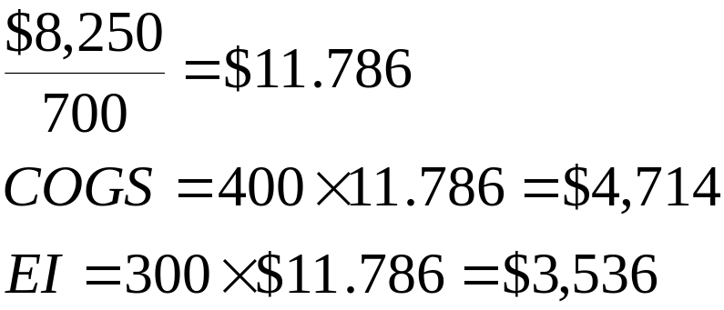
Example 10.1.4
COGS + EI: Average cost
Under the stable price scenario COGS = $4,000, EI = $3,000
Under the rising price scenario, the average cost is calculated by dividing the total cost of all units by the total number of units, this then is multiplied by the number of units sold to get COGS and the number of units remaining in inventory to get EI, as follows

Slide 19
Objective 10.1
Inventories
If prices are stable, BI + P are allocated in the same way under each of the three inventory valuation methods
If prices are rising, BI + P are allocated differently under each of the three inventory valuation methods
Method | BI | + | P | = | COGS | + | EI
FIFO | $2,000 | + | $6,250 | = | $4,300 | + | $3,950
Average cost | 2,000 | + | 6,250 | = | 4,714 | + | 3,536
LIFO | 2,000 | + | 6,250 | = | 5,150 | + | 3,100

Slide 20
Objective 10.2
Inventories
If prices are rising, FIFO results in larger inventories at the end of the period and smaller costs of goods sold during the period, than would be the result under LIFO
If prices are rising, LIFO results in larger costs of goods sold during the period and smaller inventories at the end of the period, than would be the result under FIFO
If we assume that the latest prices more accurately reflect prevailing economic conditions than earlier prices, then FIFO more accurately values the balance sheet item, inventories, and LIFO more accurately values the income statement item, cost of goods sold
  Though the Lower of cost or market inventory valuation principle will improve the LIFO inventory values when prices fall, it does not assist when prices rise

Slide 21
Objective 10.1
Inventories
Most U.S. firms use LIFO on their financial statements as the Internal Revenue Code states that if firms use LIFO on their tax returns, they must use it on their financial statements
LIFO is a popular method used on tax returns as it increases COGS, when prices are rising as they have tended to do consistently, the higher is COGS, the lower is taxable income and consequently the lower is tax payable
An analyst may need to convert the inventory values to FIFO reported values in order to accurately value inventories based on prices more reflective of current conditions

Slide 22
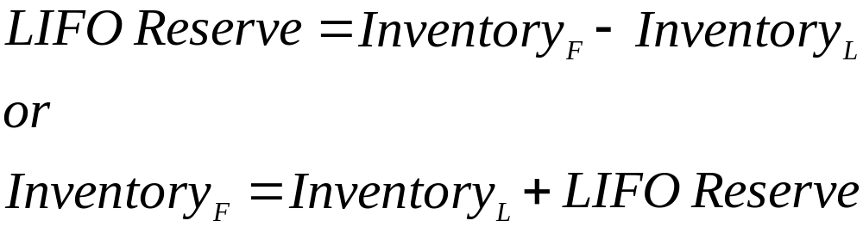
Objective 10.1
Adjustment of Inventory Balances: LIFO to FIFO
To adjust inventory values from LIFO to current or FIFO cost based values the LIFO reserve must be added to the FIFO inventory account
(10.1.1)
where
  F is FIFO method
  L is LIFO method

Slide 23
Example 10.1.5
Adjustment of Inventory Balances: LIFO to FIFO
Sonoco, a large US oil refiner, uses the LIFO method to account for virtually all crude oil and refined product inventories. Sonoco’s details of inventory and portions of financial statement footnotes are
 | 1996 | 1997 | 1998 | 1999
Crude oil | 157 | 150 | 184 | 158
Refined products | 252 | 214 | 219 | 163
LIFO reserve | 780 | 492 | 205 | 763
Adjust inventories from LIFO to FIFO

Slide 24
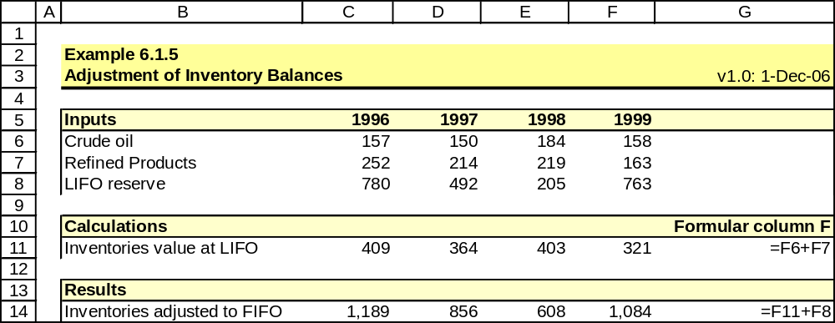
Example 10.1.5
Adjustment of Inventory Balances: LIFO to FIFO
Notes:
SEE WHITE PAGES 200-201

Slide 25


Objective 10.1
Adjustment of Cost of Goods Sold: LIFO to FIFO
COGS can be derived using the opening and closing inventory balances and purchases for the period
(10.1.2)
where
  BI is the beginning inventory
  EI is the ending inventory
  P is the purchases
Purchase is equal to
(10.1.3)

Slide 26
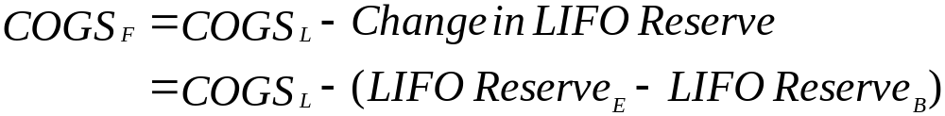
Objective 10.1
Adjustment of Cost of Goods Sold: LIFO to FIFO
The direct adjustment COGS is
(10.1.4)

Slide 27
Example 10.1.6
Adjustment of Cost of Goods Sold: LIFO to FIFO
Sonoco, a large US oil refiner, uses the LIFO method to account for virtually all crude oil and refined product inventories. Sonoco’s details of inventory and portions of financial statement footnotes are
 | 1996 | 1997 | 1998 | 1999
Crude oil | 157 | 150 | 184 | 158
Refined products | 252 | 214 | 219 | 163
COGS | 8,718 | 7,610 | 5,646 | 7,365
Inventories adj. to FIFO | 1,189 | 856 | 608 | 1,084
LIFO reserve | 780 | 492 | 205 | 763
Adjust LIFO COGS to FIFO COGS

Slide 28
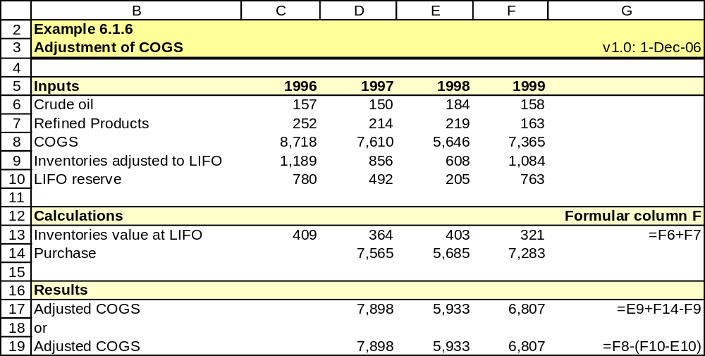
Example 10.1.6
Adjustment of Cost of Goods Sold: LIFO to FIFO
Notes:
SEE WHITE PAGES 201-202
CORRECT FORMULA IN G17 AND TITLE IN B9 TO READ FIFO

Slide 29
Objective 10.1
Adjustment of income to current cost income: FIFO to LIFO
An analyst may also want to analyse a firm’s current cost income
To do so the analyst may need to adjust a firm’s COGS to current cost of LIFO based values, if the firm uses a FIFO inventory valuation method
Unlike the conversion of LIFO values to FIFO values not all required information is available in a set of FIFO based accounts to make this adjustment, hence an approximation is required

Slide 30
Objective 10.1
Adjustment of income to current cost income: FIFO to LIFO
The approximate adjustment requires multiplying the opening inventory by the (specific) inflation rate, r, and adding the result to COGS_{F} to arrive at COGS_{L}
(10.1.5)

Slide 31
Objective 10.1
Adjustment of income to current cost income: FIFO to LIFO
The weighted-average COGS can be adjusted to current cost (LIFO)
The adjustment can be approximated by one-half the (specific) inflation rate
(10.1.6)
where
  COGS_{W} is the weighted-average COGS

Slide 32
Example 10.1.7
Adjustment of income to current cost income: FIFO to LIFO
Caltex Australia in 1999 had net revenue of $3,153m. Its operating costs and expenses is $2,936m; beginning inventory balance is $235m. The price index is 125%.
Adjust income to current cost income

Slide 33
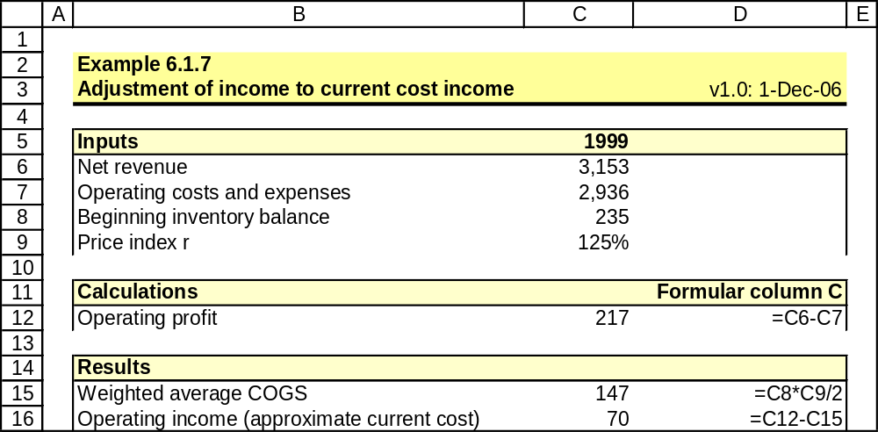
Example 10.1.7
Adjustment of income to current cost income: FIFO to LIFO
Notes:
SEE WHITE PAGES 204-205

Slide 34
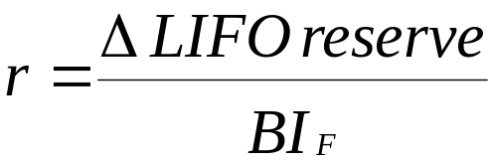
Objective 10.1
Specific inflation rate
The specific price level change for a given FIFO or weighted average firm can be estimated from data of a competing (LIFO) firm
(10.1.7)
where
  r is the price level change

Slide 35
Example 10.1.8
Specific inflation rate
Sunoco in 1999 had LIFO inventory of $403m. Beginning and ending LIFO reserves are $205m and $763m respectively.
Calculate the specific inflation rate

Slide 36
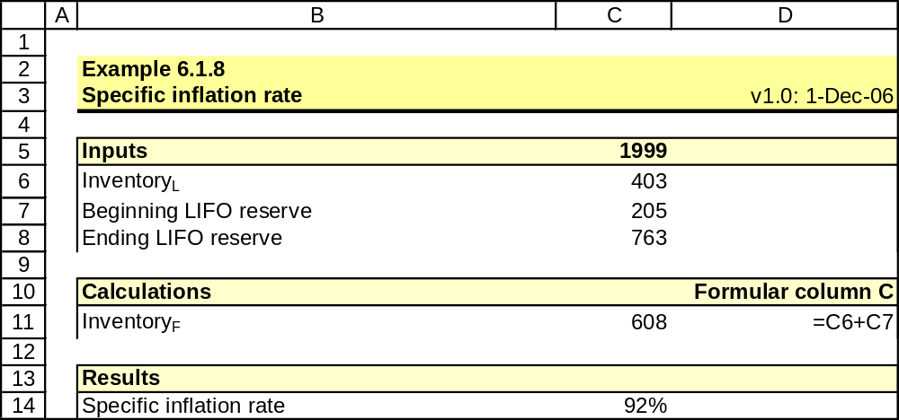
Example 10.1.8
Specific inflation rate
Notes:
SEE WHITE PAGES 205-206

Slide 37
Objective 10.3
Effect of inventory valuation methods (rising prices)
Financial ratios | FIFO | LIFO
Operations (EBIT to sales) | ✴ | ✵
x Financing (EBT to EBIT) | ― | ―
x Taxes (Net income to EBT) | ✵ | ✴
= Profitability (Net income to sales) | ✴ | ✵
x Turnover (Sales to total assets) | ✵ | ✴
x Solvency (Total assets to equity) | ✵ | ✴
= ROE (Net income to equity) | ✴ | ✵
Cash flow | ✵ ( tax paid) | ( tax paid)
Current ratio | ✴ | ✵
Notes:
SEE WHITE PAGES 206-211
THE GENERAL RULE IS TO ADJUST SO AS TO USE LIFO NUMBERS FOR RATIO COMPONENTS THAT ARE INCOME RELATED AND FIFO BASED DATA FOR COMPONENTS THAT ARE BALANCE SHEET RELATED

Slide 38
Objective 10.4
Declines in LIFO reserve
Under conditions of stable or rising prices or inventory quantities, the LIFO reserve will not decline
The LIFO reserve will decline if:
  Inventory quantities are falling
  Prices are falling
A decline in the LIFO reserve is associated with lower COGS and higher net income
The response of the analyst should be different in either case:
  If due to falling inventories, the analyst should exclude the effects of the lower LIFO reserve on COGS to arrive at a better measure of the firm’s operating performance
  If due to lower prices, no adjustment should be made

Slide 39
Objective 10.4
LIFO liquidations
A LIFO liquidation is a decline in inventory quantities as a LIFO firm, in a period of rising prices, attempts to artificially lower COGS and increase net income by using inventory rather than purchases, which are purchased at the more recent higher prices
An analyst should add back to COGS the amount by which the LIFO reserve has declined due solely to the decline in inventory quantities

Slide 40
Key Points

Slide 41
Excluded CFA learning objectives

